Slide 1
Progress report: Team 3 OP
By: Anna, Mohamed, Khoa and Sami

Slide 2
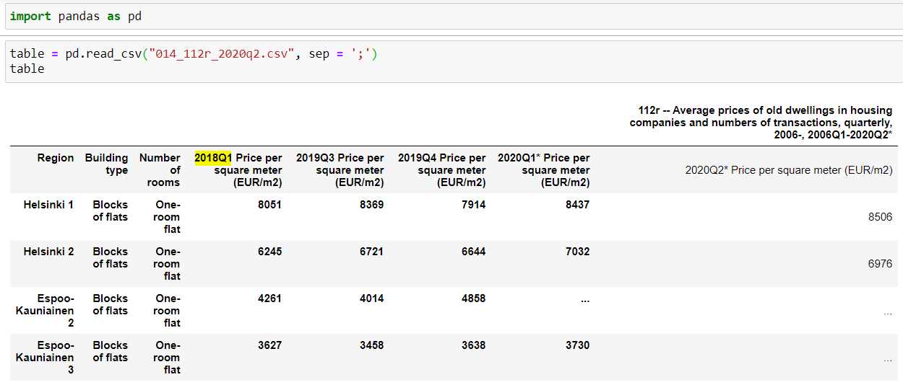
Data
We have so far used a dataset starting from 2006Q1 until 2020Q2

Slide 3
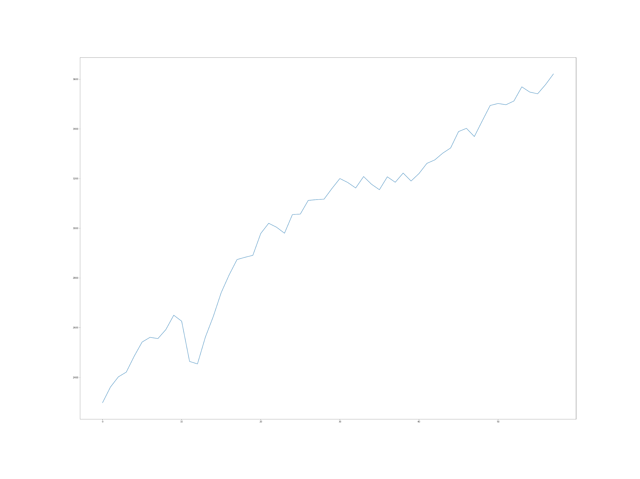
Data continues
The data that we have used only takes into account blocks of flats, and an approach using other building types will be made once a good model is found.
A function has been made to select a row of wanted features on which the model will be applied.
The data has a total of around 25% missing values (denoted in the data as ‘...’) which is a lot so imputation is needed to replace them with real values.

Slide 4
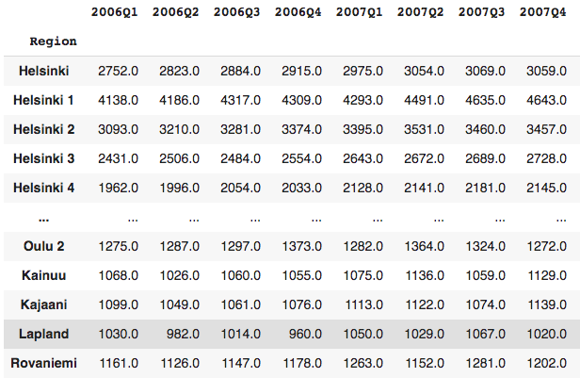
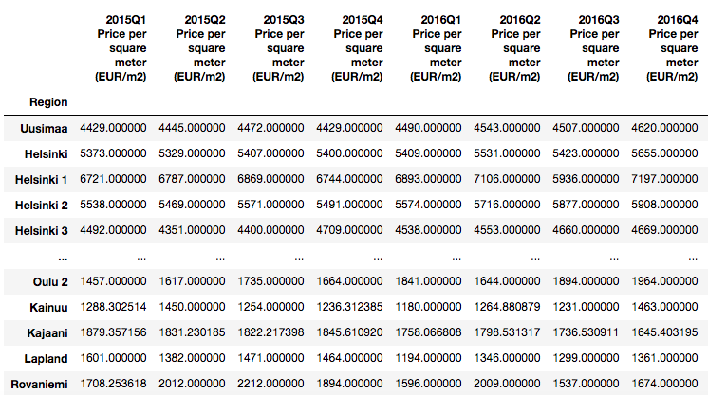
Imputations
One-room flats 2006Q1-2020Q2: 22.031%
One-room flats 2015Q1-2020Q3: 23.654%
MEAN vs. MEDIAN vs. SOMETHING ELSE?

Slide 5
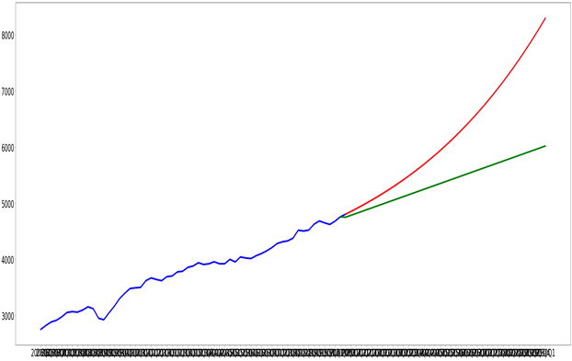
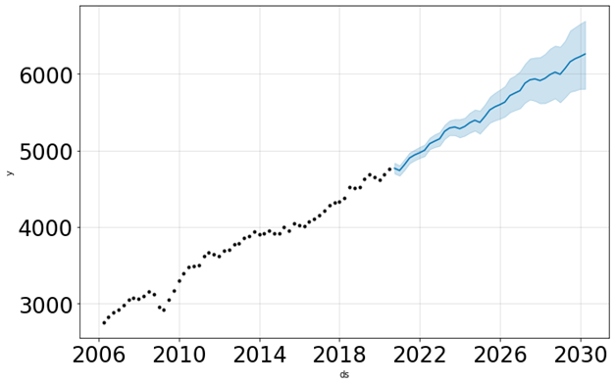
Models
Regression
Prophet
Red line = Polynomial Regression with degree = 58
Green line = Linear Regression
Solid prediction for the interval of 1 year. But not reliable for prediction in the long run
Blue line = prediction
Blue interval = error interval
Better forecasting with fluctuation of the time series taken into account.

Slide 6
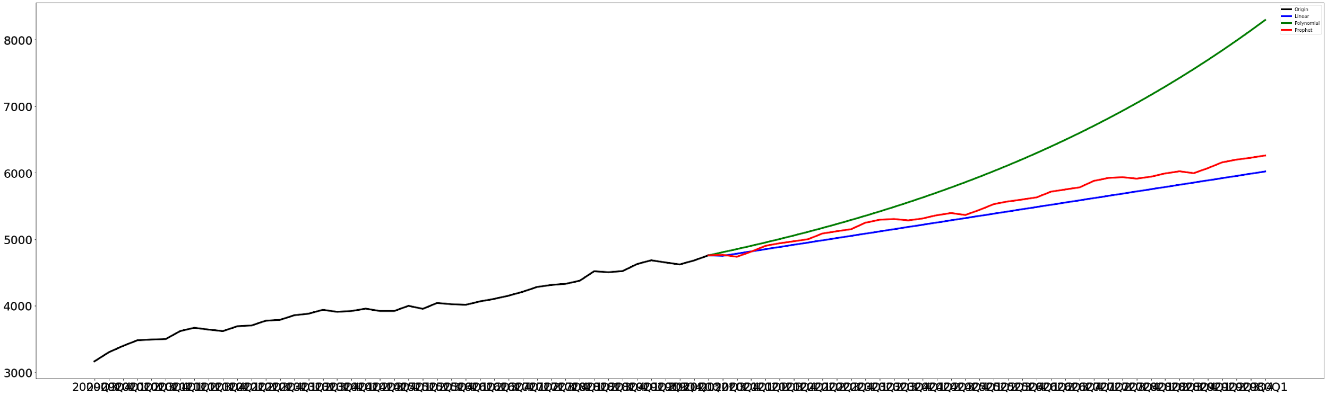
Comparing models’ performances
Helsinki Block of flats Total

Slide 7
Questions for OP
Is a model that can predict using postal codes needed or is it enough to do predictions by region?
At the end of the project, what kind of method/UI of the model needs to be provided?

